Slide 1
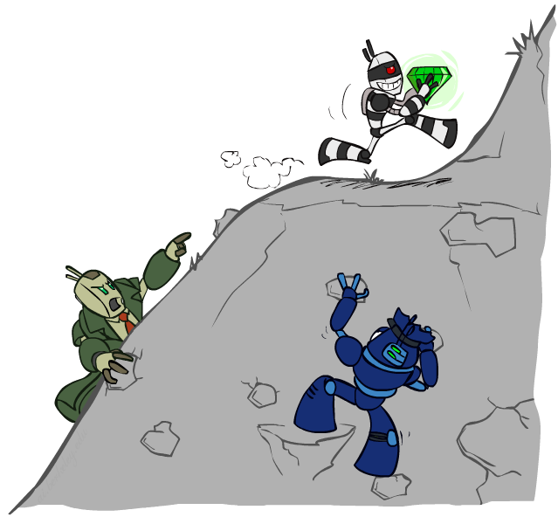
CSE 511A: Introduction to Artificial Intelligence
Constraint Satisfaction Problems II
Instructors: Roman Garnett
Washington University in St. Louis
[These slides were created by Dan Klein and Pieter Abbeel for CS188 Intro to AI at UC Berkeley. All CS188 materials are available at http://ai.berkeley.edu.]
Notes:
Please retain proper attribution, including the reference to ai.berkeley.edu. Thanks!

Slide 2

Today
Efficient Solution of CSPs
Local Search

Slide 3


Reminder: CSPs
CSPs:
Variables
Domains
Constraints
Implicit (provide code to compute)
Explicit (provide a list of the legal tuples)
Unary / Binary / N-ary
Goals:
Here: find any solution
Also: find all, find best, etc.

Slide 4
Backtracking Search
Notes:
Assign one variable at a time. Basically DFS implemented recursively, but we (a) do iterative goal tests rather than final ones so that we can bail out and also trim successors as we go along.
Some questions like what order?

Slide 5


Improving Backtracking
General-purpose ideas give huge gains in speed
… but it’s all still NP-hard
Filtering: Can we detect inevitable failure early?
Ordering:
Which variable should be assigned next? (MRV)
In what order should its values be tried? (LCV)
Structure: Can we exploit the problem structure?
Notes:
Ordering: hard variables ones first, might as well do them now before you get too deep in the tree, also try least constraining value first
Filtering: try to detect problems before they happen, forward checking and arc consistency

Slide 6

Ordering

Slide 7
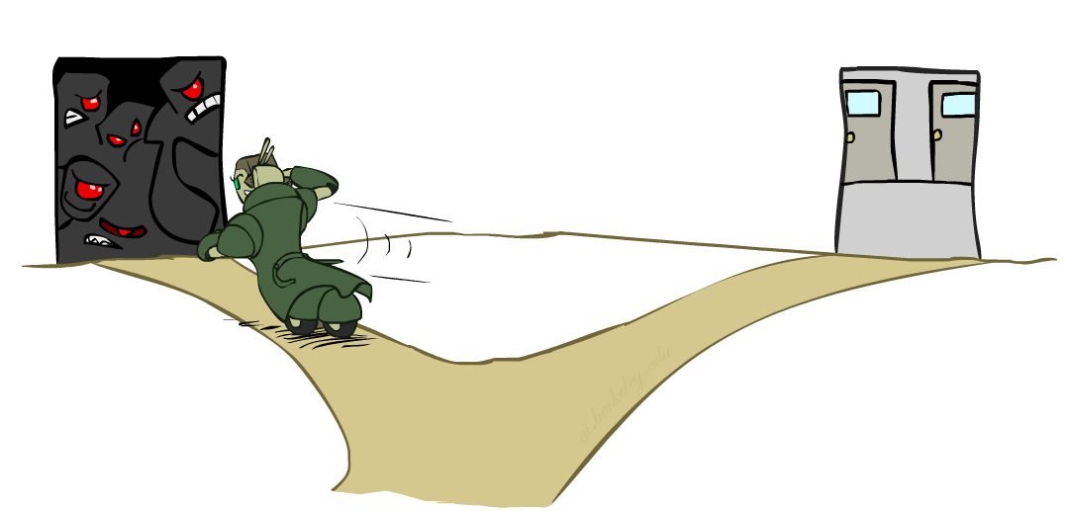
Ordering: Minimum Remaining Values
Variable Ordering: Minimum remaining values (MRV):
Choose the variable with the fewest legal left values in its domain
Why min rather than max?
Also called “most constrained variable”
“Fail-fast” ordering

Slide 8
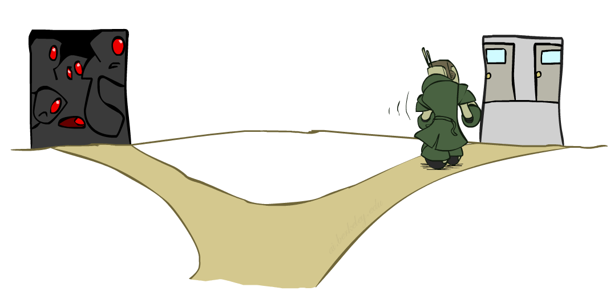
Ordering: Least Constraining Value
Value Ordering: Least Constraining Value
Given a choice of variable, choose the least constraining value
I.e., the one that rules out the fewest values in the remaining variables
Note that it may take some computation to determine this! (E.g., rerunning filtering)
Why least rather than most?
Combining these ordering ideas makes
1000 queens feasible

Slide 9

Arc Consistency and Beyond

Slide 10
Arc Consistency of an Entire CSP
A simple form of propagation makes sure all arcs are simultaneously consistent:
Arc consistency detects failure earlier than forward checking
Important: If X loses a value, neighbors of X need to be rechecked!
Must rerun after each assignment!
NT
Q
WA
SA
NSW
V
Remember: Delete from the tail!
Notes:
Look at all arcs, check they’re all consistent, deleting values as we go along
Check if there is always a value in the tail that has a value in the head that satisfies the constraint.

Slide 11
Limitations of Arc Consistency
After enforcing arc consistency:
Can have one solution left
Can have multiple solutions left
Can have no solutions left (and not know it)
Arc consistency still runs inside a backtracking search!
What went wrong here?
Notes:
Only looks at pairs, doesn’t solve bottom example

Slide 12

K-Consistency
Notes:
Pulled over by robocop

Slide 13
K-Consistency
Increasing degrees of consistency
1-Consistency (Node Consistency): Each single node’s domain has a value which meets that node’s unary constraints
2-Consistency (Arc Consistency): For each pair of nodes, any consistent assignment to one can be extended to the other
K-Consistency: For each k nodes, any consistent assignment to k-1 can be extended to the k^{th} node.
Higher k more expensive to compute
(You need to know the k=2 case: arc consistency)
Notes:
Unary constraints are just restricted domain.
Binary consistency is just arc consistency.
K-consistency would fix bottom eample

Slide 14
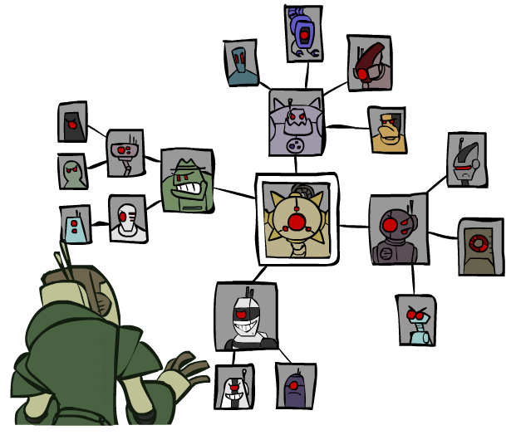
Structure
Notes:
Filtering, finding problems before they happen in the search
Ordering, try nodes/value in a useful order
Structure! (middle guy useful?)

Slide 15
Problem Structure
Extreme case: independent subproblems
Example: Tasmania and mainland do not interact
Independent subproblems are identifiable as connected components of constraint graph
Suppose a graph of n variables can be broken into subproblems of only c variables:
Worst-case solution cost is O((n/c)(d^{c})), linear in n
E.g., n = 80, d = 2, c =20
2⁸⁰ = 4 billion years at 10 million nodes/sec
(4)(2²⁰) = 0.4 seconds at 10 million nodes/sec
Notes:
Sometimes structure leads to insight, for example, here we have two pieces.
Independent subproblems can be a huge advantage! Pretty rare though.

Slide 16
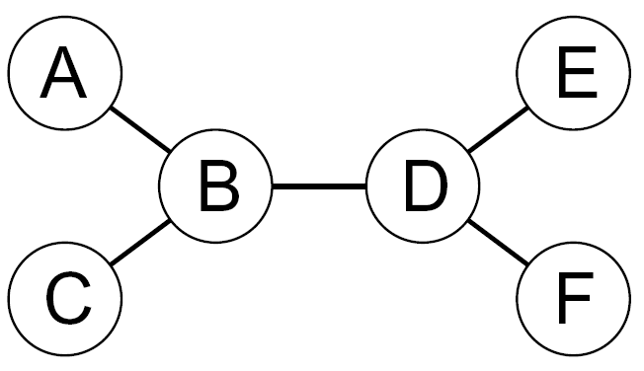
Tree-Structured CSPs
Theorem: if the constraint graph has no loops, the CSP can be solved in O(n d²) time
Compare to general CSPs, where worst-case time is O(d^{n})
This property also applies to probabilistic reasoning (later): an example of the relation between syntactic restrictions and the complexity of reasoning
Notes:
In between general graphs and disconnected graphs are trees! CSPs can be solved in linear time rather than exponential time. Not too rare either.
Restricting the problems makes the reasoning easier.

Slide 17
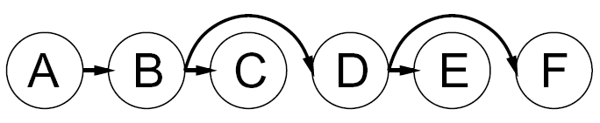


Tree-Structured CSPs
Algorithm for tree-structured CSPs:
Order: Choose a root variable, order variables so that parents precede children
Remove backward: For i = n : 2, apply RemoveInconsistent(Parent(X_{i}),X_{i})
Assign forward: For i = 1 : n, assign X_{i} consistently with Parent(X_{i})
Runtime: O(n d²) (why?)
Notes:
Once you choose a root you have direction (could be many choices). Now arc consistency becomes easier. One one arc into each node!
Only did a single pass, not full arc consistency.
Now we made the arcs consistent, we can go left to right!
Can we?

Slide 18
Tree-Structured CSPs
Claim 1: After backward pass, all root-to-leaf arcs are consistent
Proof: Each X→Y was made consistent at one point and Y’s domain could not have been reduced thereafter (because Y’s children were processed before Y)
Claim 2: If root-to-leaf arcs are consistent, forward assignment will not backtrack
Proof: Induction on position
Why doesn’t this algorithm work with cycles in the constraint graph?
Note: we’ll see this basic idea again with Bayes’ nets
Notes:
Pick an arc, e.g. B->D, at some point it was consistent…what about at the end? But all arcs are on the left. I only need to rerun when I delete a value from the head, but that never happens.
Imagine E had two parents, D->E and C->E, now the assignment at E consistent with D might not be the same as the one consistent with C

Slide 19

Iterative Improvement
Notes:
New idea: try incorrect solution and modify it to be correct.

Slide 20
Iterative Algorithms for CSPs
Local search methods typically work with “complete” states, i.e., all variables assigned
To apply to CSPs:
Take an assignment with unsatisfied constraints
Operators reassign variable values
No fringe! Live on the edge.
Algorithm: While not solved,
Variable selection: randomly select any conflicted variable
Value selection: min-conflicts heuristic:
Choose a value that violates the fewest constraints
I.e., hill climb with h(n) = total number of violated constraints
Notes:
Local search takes in complete assignment but incorrect.
Instead of backtracking, you reassign variables.

Slide 21
Example: 4-Queens
States: 4 queens in 4 columns (4⁴ = 256 states)
Operators: move queen in column
Goal test: no attacks
Evaluation: c(n) = number of attacks
[Demo: n-queens – iterative improvement (L5D1)]
[Demo: coloring – iterative improvement]
Notes:
L5D1 – python demos
Coloring – javascript demos

Slide 22

Video of Demo Iterative Improvement – n Queens

Slide 23
Video of Demo Iterative Improvement – Coloring

Slide 24
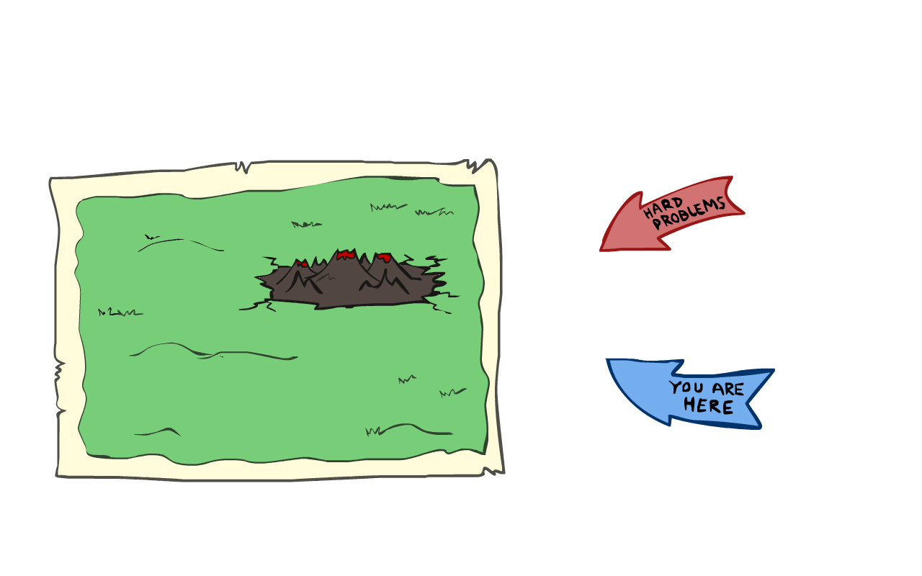
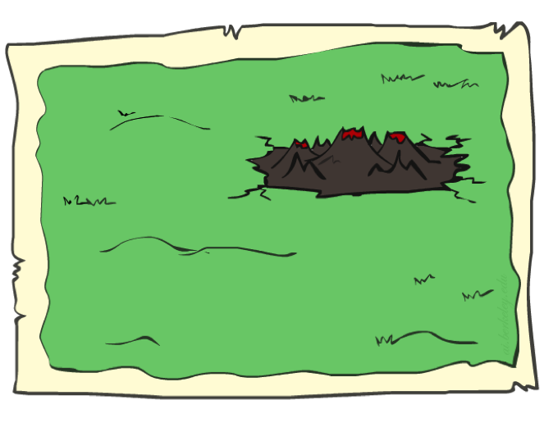
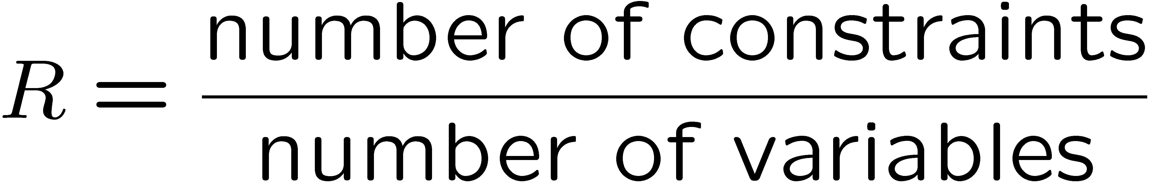
Performance of Min-Conflicts
Given random initial state, can solve n-queens in almost constant time for arbitrary n with high probability (e.g., n = 10,000,000)!
The same appears to be true for any randomly-generated CSP except in a narrow range of the ratio
Notes:
Huge improvement in n-queens problem.
Also true in random CSPs. They’re almost all easy.
There is a critical range though.
Lots of variables no constraints? Easy
Lots of constraints no variables? Also turns out easy.
Critical ratio you do a ton of work just to see it barely didn’t work.
Naturally occurring CSPs turn out to be hard.

Slide 25
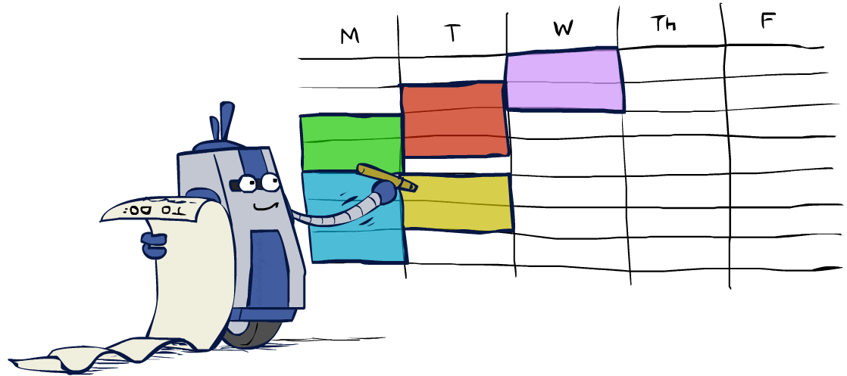
Summary: CSPs
CSPs are a special kind of search problem:
States are partial assignments
Goal test defined by constraints
Basic solution: backtracking search
Speed-ups:
Ordering
Filtering
Structure
Iterative min-conflicts is often effective in practice

Slide 26

Local Search

Slide 27
Local Search
Tree search keeps unexplored alternatives on the fringe (ensures completeness)
Local search: improve a single option until you can’t make it better (no fringe!)
New successor function: local changes
Generally much faster and more memory efficient (but incomplete and suboptimal)

Slide 28
Hill Climbing
Simple, general idea:
Start wherever
Repeat: move to the best neighboring state
If no neighbors better than current, quit
What’s bad about this approach?
Complete?
Optimal?
What’s good about it?
Notes:
Not complete, not optimal, but why use it? Often useful!

Slide 29
Hill Climbing Diagram
Notes:
No idea if the maximum you’re at is good…

Slide 30
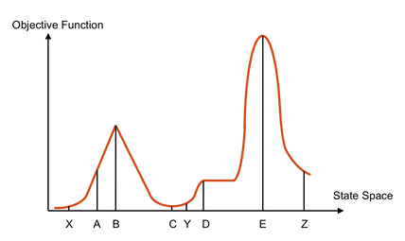
Hill Climbing Quiz
Starting from X, where do you end up ?
Starting from Y, where do you end up ?
Starting from Z, where do you end up ?

Slide 31

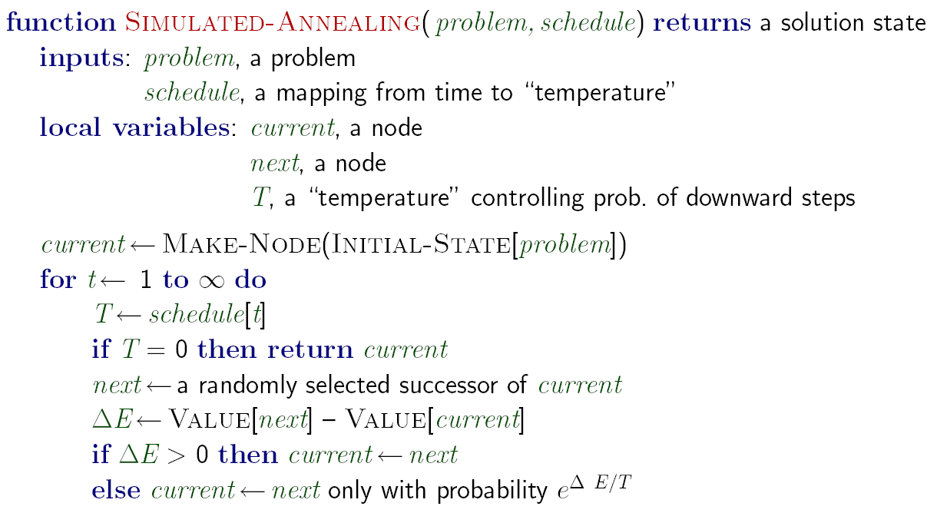
Simulated Annealing
Idea: Escape local maxima by allowing downhill moves
But make them rarer as time goes on
Notes:
Idea: sometimes go downhill! Knocks you out of bad local maxima.

Slide 32
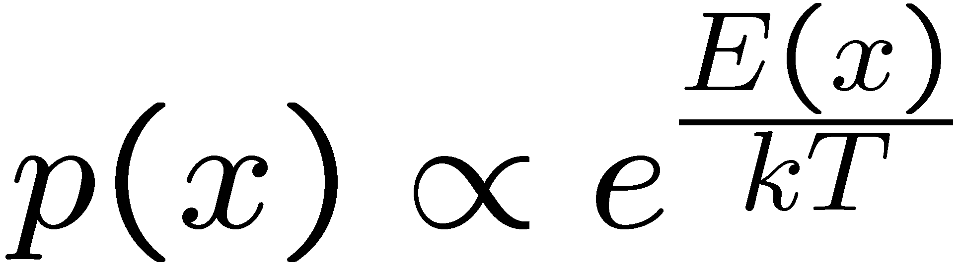
Simulated Annealing
Theoretical guarantee:
Stationary distribution:
If T decreased slowly enough,
will converge to optimal state!
Is this an interesting guarantee?
Sounds like magic, but reality is reality:
The more downhill steps you need to escape a local optimum, the less likely you are to ever make them all in a row
People think hard about ridge operators which let you jump around the space in better ways

Slide 33

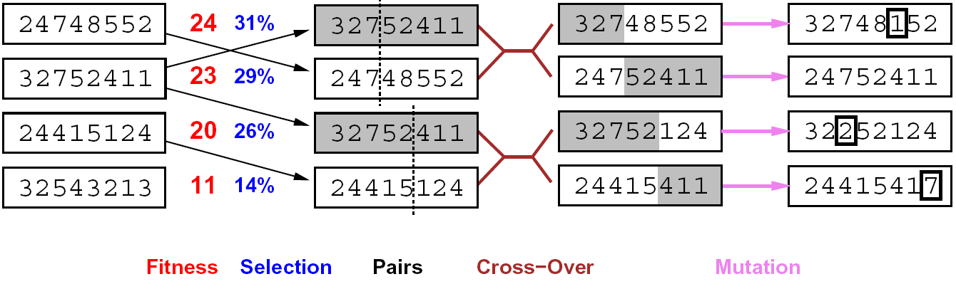
Genetic Algorithms
Genetic algorithms use a natural selection metaphor
Keep best N hypotheses at each step (selection) based on a fitness function
Also have pairwise crossover operators, with optional mutation to give variety
Possibly the most misunderstood, misapplied (and even maligned) technique around

Slide 34
Example: N-Queens
Why does crossover make sense here?
When wouldn’t it make sense?
What would mutation be?
What would a good fitness function be?

Slide 35
Next Time: Adversarial Search!

